Slide 1
Automatic Text Summarizer
By
Name: Gampa Sai Sonu
enrollno:23STUCHH010180
Under the Guidance of
L.Lakshmi
(Assisstant Professor)

Slide 2

CONTENTS:
Objectives
Existing System
Proposed System
Hardware and Software Requirements

Slide 3
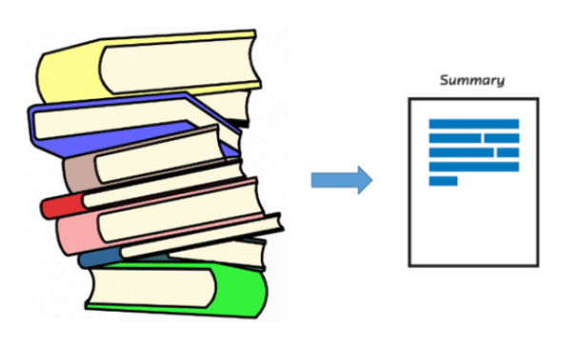
Objectives:
The main objective is to reduce a given body of text to a fraction of its size, maintaining coherence and semantics.
To reduce the reading time. While researching documents, summaries make selection process easier.

Slide 4
Existing System:
Model Evaluation:
A summary is a text that is produced out of one or more texts, that contains the same information of the original text, and that is no longer than half of the original text.
Any summary can be characterized by three major classes of characteristics:
Input: characteristics of the source text
Source size: single-document vs. multi-document
Specificity: domain-specific vs. general

Slide 5
Existing Techniques:
We generalized several privileged positions, such as first and last sentences results, developing a method for automatically identifying the sentence positions most likely to yield good summary sentences. The training phase of this method calculates the yield of each sentence position by comparing the similarity between human-created abstracts and the contents of the sentence in each ordinal position in the corresponding texts.

Slide 6

Drawbacks:
No logical relation for sentence arrangement.
Sentence structure identification is not accurate.
Article distribution is not relevant.

Slide 7
Proposed System:
Purpose: characteristics of the summary usage
Audience: Generic vs. query-oriented
Usage: Indicative vs. informative
Expansiveness: Background vs. just-the-news

Slide 8
Proposed techniques:
Two sets of phrases are identified--bonus phrases and stigma--phrases. Bonus phrases such as "in summary", "in conclusion", and superlatives such as "the best", "the most important" can be good indicators of important content.Unfortunately, cue phrases are genre dependent.During processing, the Cue Phrase Module simply rewards each sentence containing a cue phrase with an appropriate score and penalizes those containing stigma phrases For example, "Abstract" and "in conclusion" are more likely to occur in scientific literature than in newspaper articles.

Slide 9
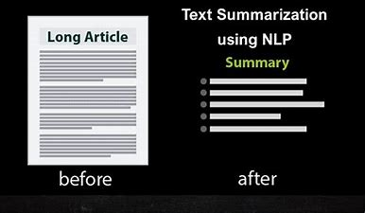
Advantages:
Increases productivity level.
Suitable for any language.
It includes all the important facts.
Instant response.

Slide 10
System Requirements:
HARDWARE REQUIREMENTS
PROCESSOR : DUAL CORE 2 DUO.
RAM : 2GB DD RAM
HARD DISK : 250 GB
SOFTWARE REQUIREMENTS
FRONT END : PYTHON
OPERATING SYSTEM : WINDOWS 7
IDE : Spyder3

Slide 11
Thank you

